Slide 1



The spatial configuration of the molecule
Al-Farabi Kazakh National University
Faculty of Chemistry and Chemical technology
Department of General and Inorganic Chemistry
pHd Bakhadur askar

Slide 2
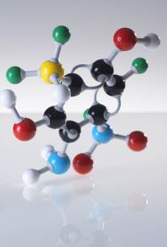
Molecular Configuration
The spatial configuration of a molecule refers to the three-dimensional arrangement of its atoms in space.
It plays a crucial role in determining chemical reactivity, physical properties, and biological activity.
Molecules with the same atomic composition can have different spatial arrangements — leading to isomerism.
The study of molecular configuration combines valence bond theory, VSEPR (Valence shell electron pair repulsion) model, and hybridization concepts.

Slide 3
Factors Determining Molecular Geometry
Number of electron pairs around the central atom (bonding + lone pairs).
Repulsion between electron domains according to the VSEPR (Valence Shell Electron Pair Repulsion) theory.
Type of chemical bonds (single, double, triple) — affect bond lengths and angles.
Hybridization state of the central atom (sp, sp², sp³, sp³d, sp³d²).
Presence of lone pairs causes distortion from ideal geometries.
Intermolecular forces and steric effects can also influence final structure.

Slide 4
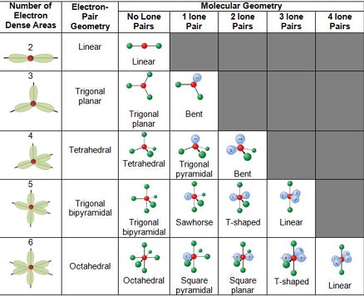
The VSEPR Theory
Developed by Gillespie and Nyholm (1950s) to predict molecular shapes.
Basic principle: Electron pairs around a central atom arrange themselves to minimize repulsion.
Key electron domain geometries:
2 domains → Linear (180°)
3 domains → Trigonal planar (120°)
4 domains → Tetrahedral (109.5°)
5 domains → Trigonal bipyramidal (90° and 120°)
6 domains → Octahedral (90°)
Example: CH₄ (tetrahedral), NH₃ (trigonal pyramidal), H₂O (bent).

Slide 5
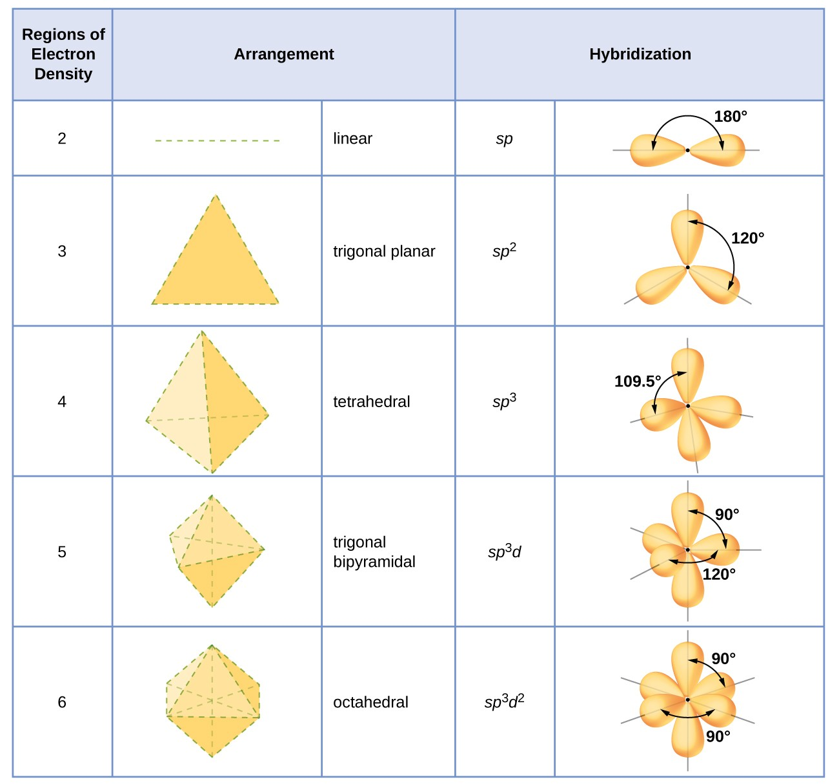
Hybridization and Spatial Arrangement
Hybridization explains how atomic orbitals mix to form new orbitals that determine bond directions.
Types and geometries:
sp → Linear (180°) — BeCl₂
sp² → Trigonal planar (120°) — BF₃
sp³ → Tetrahedral (109.5°) — CH₄
sp³d → Trigonal bipyramidal — PCl₅
sp³d² → Octahedral — SF₆
The degree of hybridization and bond character directly affects bond angles and molecular shape.

Slide 6
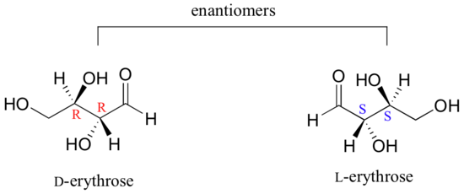
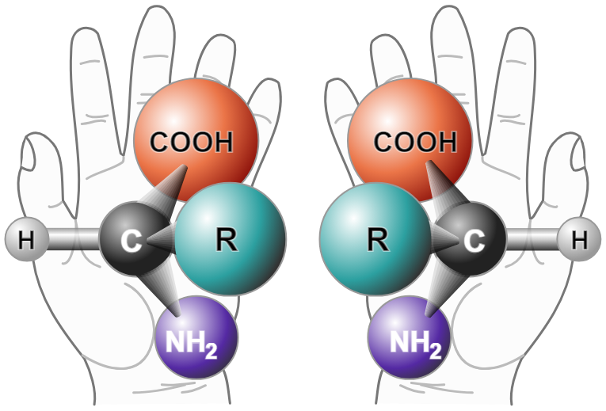
Chirality and Stereoisomerism
Chirality refers to molecules that cannot be superimposed on their mirror images.
Molecules with one or more chiral centers (asymmetric carbon atoms) exhibit optical isomerism.
Enantiomers are mirror-image isomers with identical physical properties but different biological activities.
Example:
L- and D- forms of amino acids or glucose.
Spatial configuration determines how molecules interact with biological receptors and enzymes.

Slide 7
Molecular Geometry and Properties
Polarity: Distribution of charge depends on shape and bond dipoles.
Spectroscopic behavior: Shape affects IR and Raman spectra.
Reactivity: Certain geometries favor specific reaction pathways.
Boiling and melting points: Influenced by intermolecular interactions (e.g., H-bonding).
Example:
CO₂ (linear, nonpolar)
H₂O (bent, polar).

Slide 8
Conclusion
The spatial configuration of molecules defines their identity, reactivity, and function.
Determined by electron pair repulsion, bond type, and hybridization.
VSEPR theory provides a practical framework for predicting molecular shapes.
Chirality and stereochemistry demonstrate the importance of 3D structure in chemistry and biology.
Understanding molecular configuration is fundamental to organic synthesis, biochemistry, and material design.

Slide 9

Questions?

